Slide 1
Designing A Cloud Solution
By Daragh Murnane, Philip Herweling and Patrick Moxham

Slide 2
Introduction
The goal of this assignment was to bring together our previous work in the labs and design a cloud architecture solution for a medical company.
To complete this project, we reviewed the detailed customer requirements as a group and discussed different solutions.
Once everyone in the group was happy with the solution discussed we filled out the worksheets that were provided. Before we began filling out the worksheets, we completed an example of our architecture in draw.io.

Slide 3
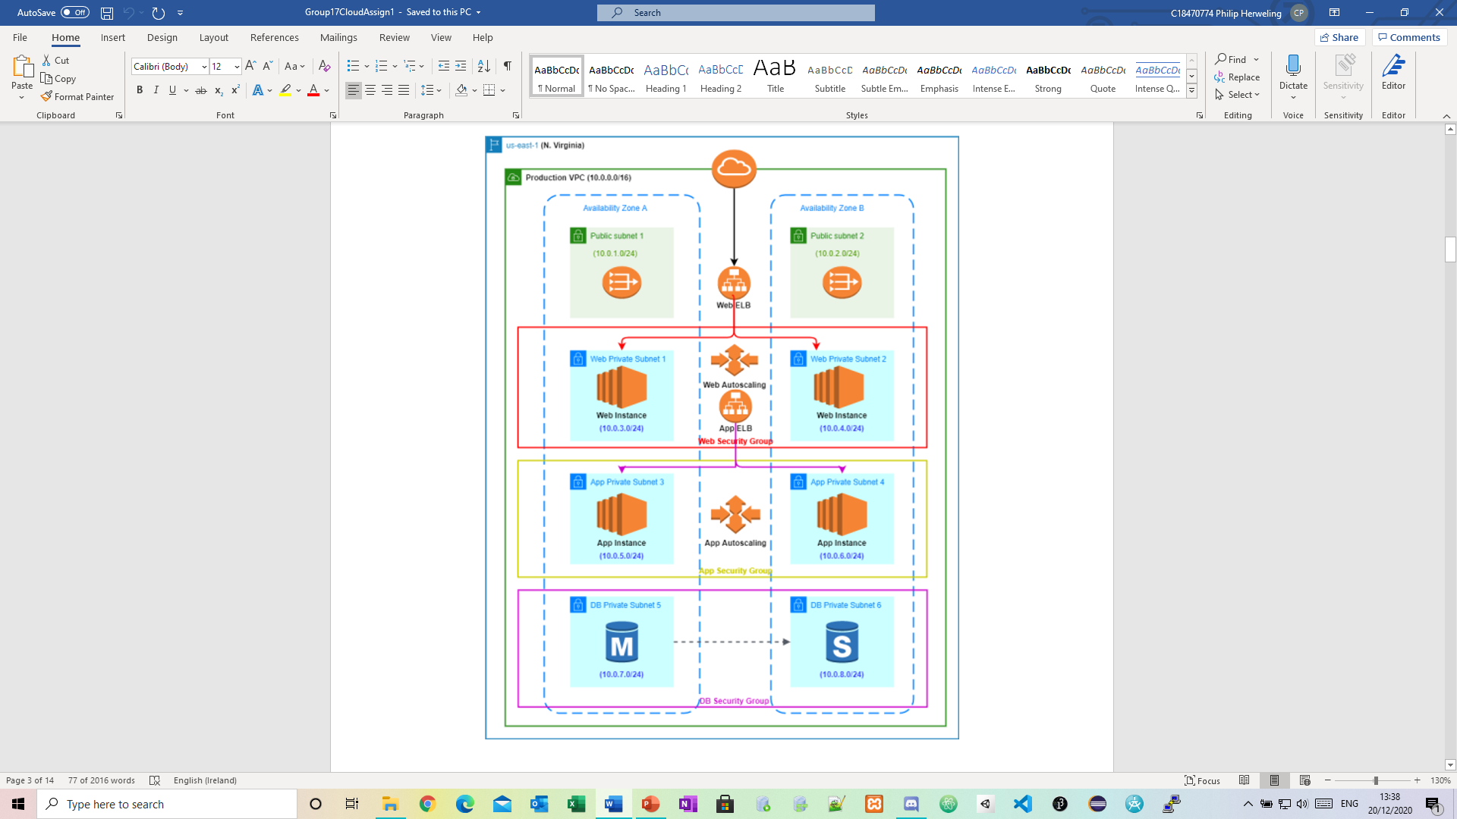

Slide 4

Potential services needed
Identity Access Management (IAM)
Amazon Virtual Private Cloud (VPC)
Amazon Elsatic Compute Cloud (EC2)
Amazon Simple Storage (S3)
Auto Scaling
Elastic Load Balancer (ELB)
Relational Database Service (RDS)
CloudTrail

Slide 5
Detailed Requirements – Detailed Authentication
Administrators would require a programmatic access and AWS Management Console access.
All other users should only have AWS Console Management access, using a combination of username and password.
We configured the password policy according to the industry standards.

Slide 6

User Authentication

Slide 7
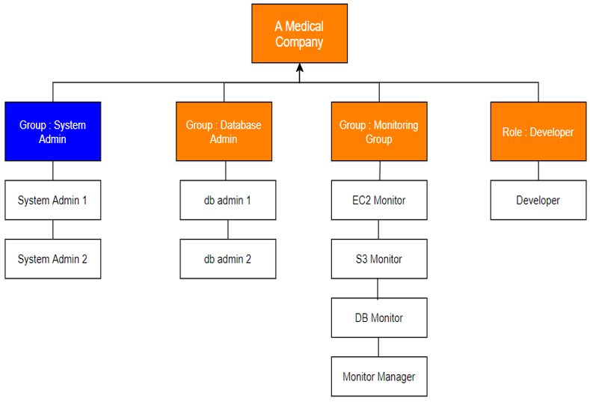

Slide 8
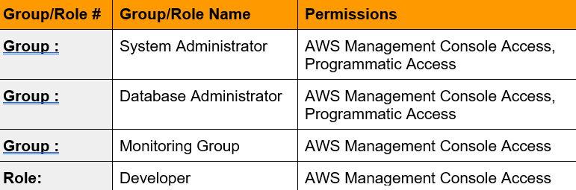

Slide 9
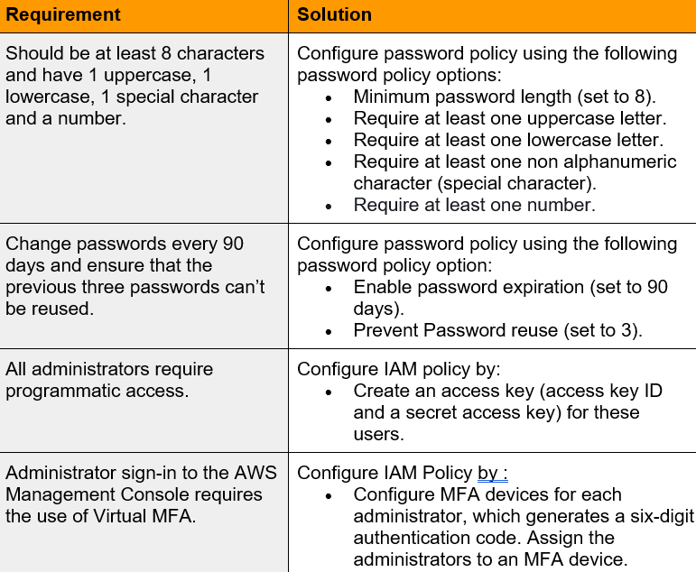

Slide 10
Network and Security

Slide 11
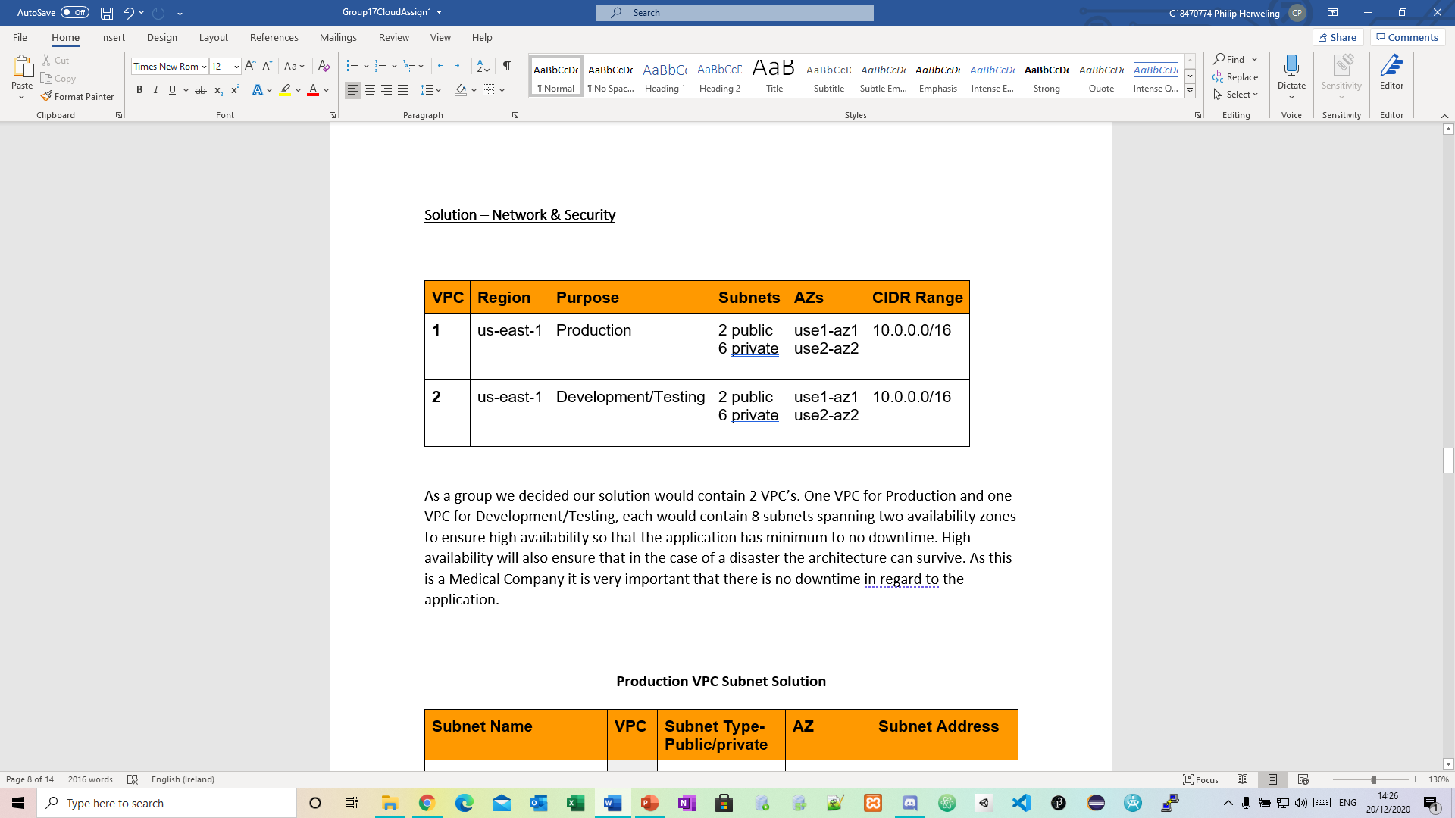
VPC’s
Two VPC’s spanning two availability zones
One VPC for Production
One VPC for Development and Testing

Slide 12
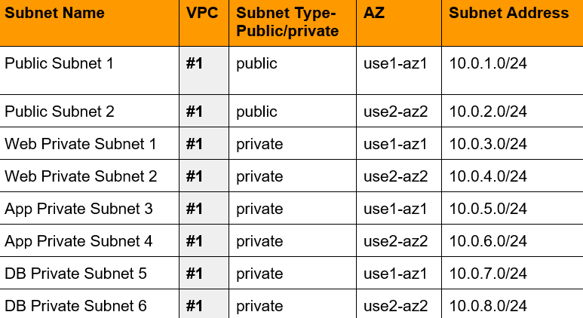
Production VPC Subnet Solution

Slide 13
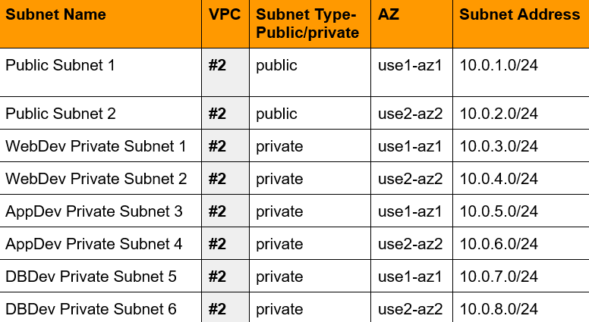
Development and Testing VPC Subnet Solution

Slide 14
Web and Application Tiers

Slide 15
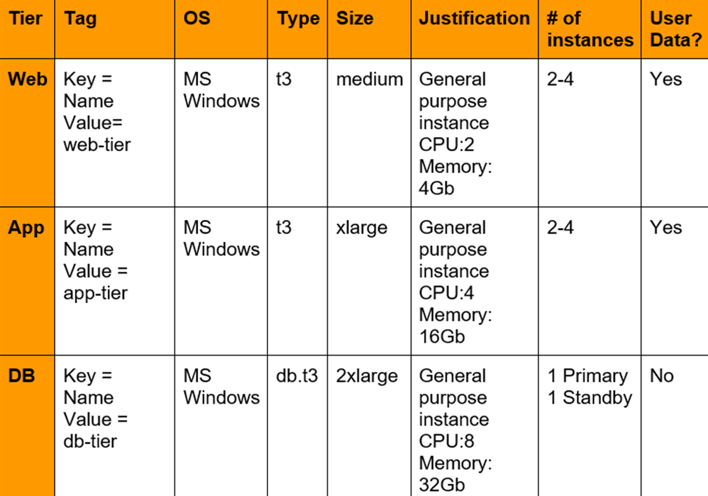
Instances
We developed our instance according to the medical company specification
We created separate instance for our web, app and db tier.

Slide 16
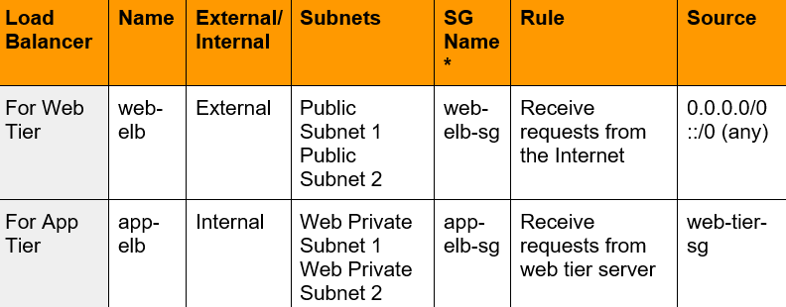
Load Balancers
We create two Elastic load balancers
This way we can ensure high availability by distributing traffic across the subnets.

Slide 17
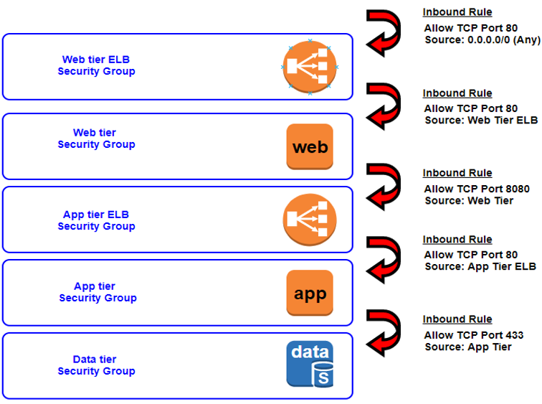
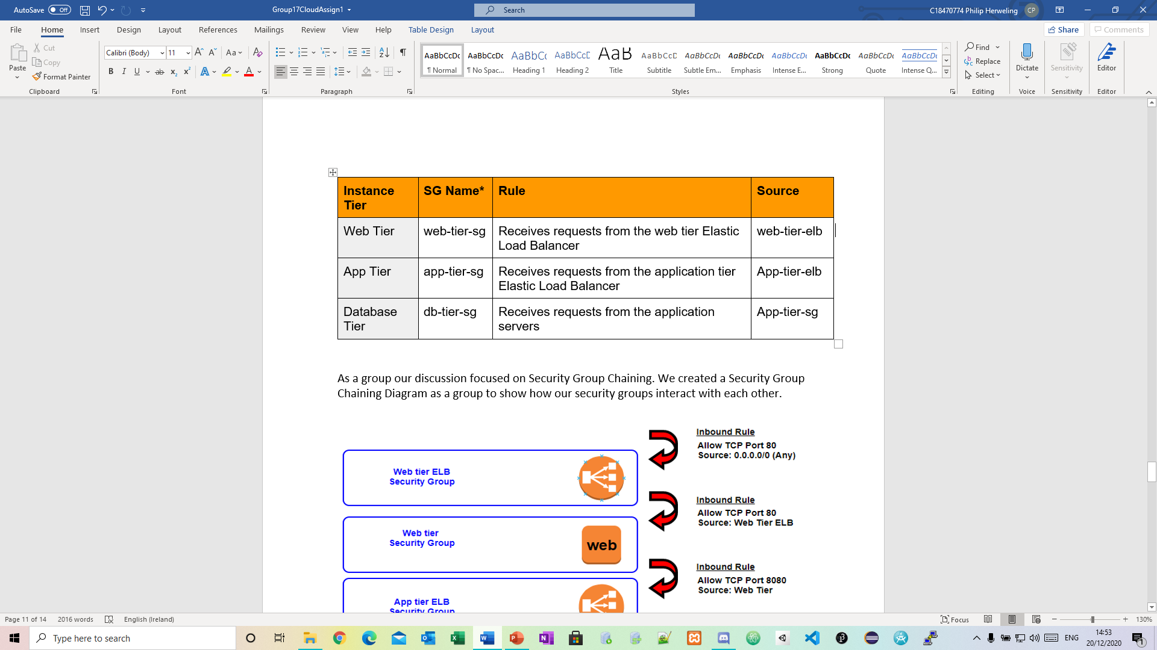
Security Group Chaining

Slide 18
Business Continuity

Slide 19
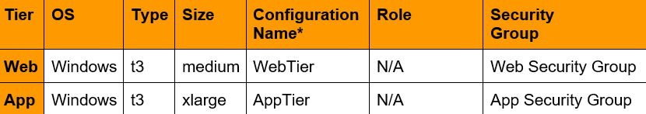
Launch Configuration
We Create two launch configurations called WebTier and AppTier
We use these launch configuration when creating our Auto Scaling groups.

Slide 20
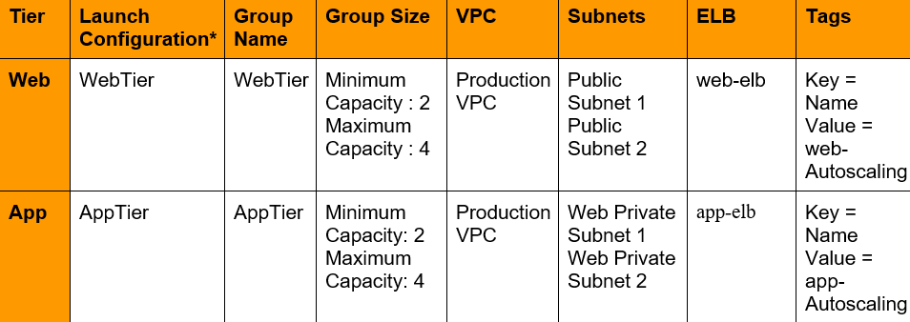
Autoscaling Groups
These autoscaling groups enable us to use amazon EC2 autoscaling features such as health check replacements and scaling policies.
These enable high availability which is vital for the medical company.

Slide 21
Auditing

Slide 22

CloudTrail
Compliance Aid
Security Analysis
Data Exfiltration
Operational Issue Troubleshooting
Unusual Activity Detection
Data Events
Management Events

Slide 23

Conclusion

